Slide 1
Supermarket Billing System
A C++ Project

Slide 2
What is it?

Slide 3
What is it?
It is a computer based software that is able to calculate the total cost of the goods customer is about to buy, prepare an invoice for him and keep records of all those transactions for future .

Slide 4
Time is the new money.
-

Slide 5
Advantages

Slide 6
Advantages
Saves time for both customer and the seller.

Slide 7
Advantages
Saves time for both customer and the seller.
Accurate calculations.

Slide 8
Advantages
Saves time for both customer and the seller.
Accurate calculations.

Slide 9
Challenges
Making a software that would be able to :
Calculate the total cost of the goods.
Save time through automation of tasks.
Keep record of transactions and customer information.
Use features of OOP approach.

Slide 10
How does the program work?

Slide 11
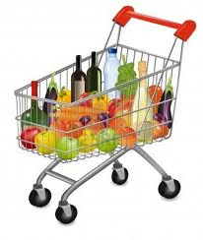
customer

Slide 12
customer
Products have their unique product id.

Slide 13
customer
Products have their unique product id.
Database of products: Product Price Soap 12
Shampoo 34
……………
……………….
…………

Slide 14
customer
Products have their unique product id.
Database of products: Product Price Soap 12
Shampoo 34
……………
……………….
…………
Invoice
Name of customer:
Address:
Contact no:
Particulars Qty Price
Soap 12 144

Slide 15
Setting Up the system

Slide 16
Setting Up the system
Goods to be sold are given unique product codes.
Database of the goods is setup with name, price and discount to be given.

Slide 17
Setting Up the system
Goods to be sold are given unique product codes.
Database of the goods is setup with name, price and discount to be given.
After the database is ready we can start using the program to create bills.

Slide 18
Features of our program

Slide 19
Features of our program
Automated Calculations

Slide 20
Features of our program
Automated Calculations
Database for products

Slide 21
Features of our program
Automated Calculations
Database for products

Slide 22
Features of our program
Automated Calculations
Database for products
Record of all the transactions
Password protected

Slide 23
Screenshots

Slide 24
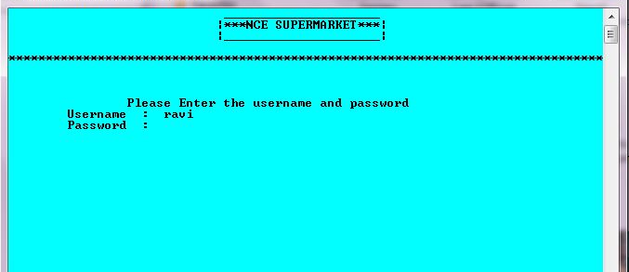
Verify User through username and password

Slide 25
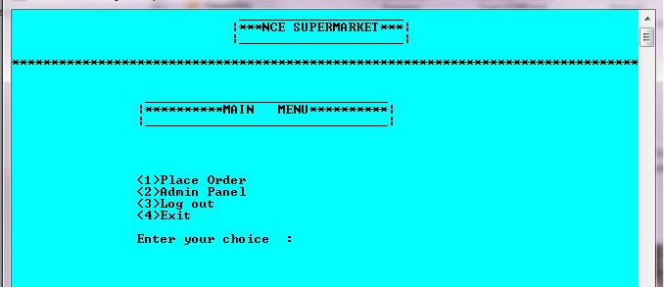
Main Menu
It is displayed only if Username and password are correct

Slide 26
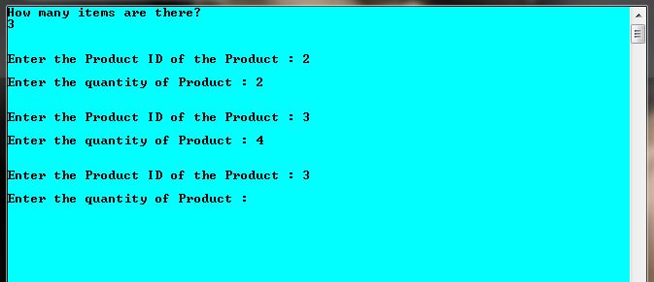
Creating a Bill
Product id is entered which will fetch their price from the database

Slide 27
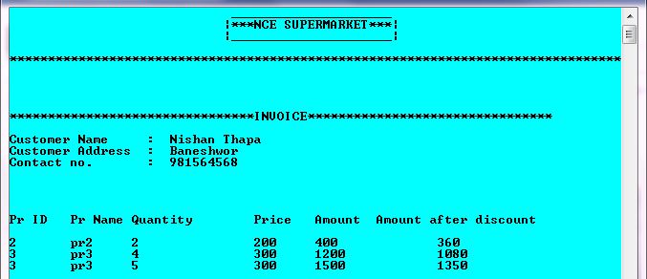
An Invoice

Slide 28
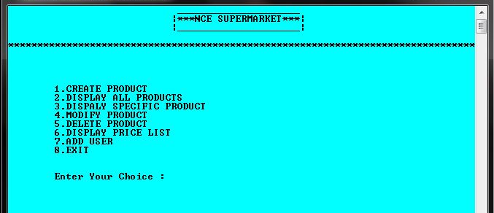
Admin Panel

Slide 29
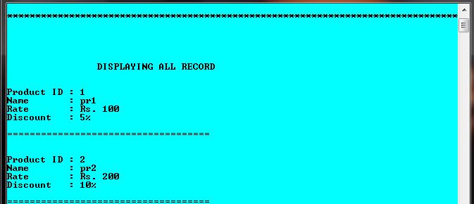
Product database

